Slide 1
Murach’s ASP.NET Core MVC (2nd Ed.)
Chapter 17
How to deploy ASP.NET Core MVC apps

Slide 2
Objectives (part 1)
Applied
Use Visual Studio’s publish feature to deploy a web app to the file system or to Azure.
Use the Azure portal to manage the apps that you’ve deployed, including deleting an app.
Knowledge
Describe how to add, edit, rename, and delete publish profiles.
Describe the general procedure for working with the Publish wizard.
List and describe some of the targets you can publish to using the Publish wizard.
Describe the general procedure for publishing an app to the file system.
Describe how to deploy an app that’s ready to publish.

Slide 3
Objectives (part 2)
Describe how to deploy changes to a published app.
Describe the general procedure for publishing a simple web app to the Azure cloud platform.
Describe the general procedure for publishing a data-driven web app to the Azure cloud platform.

Slide 4
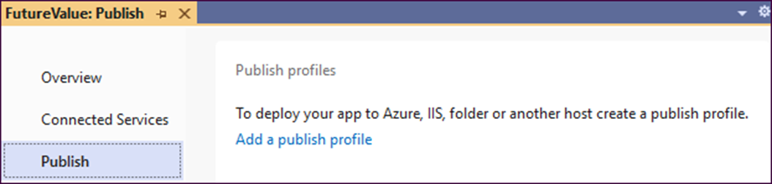
A Publish window with no publish profiles

Slide 5
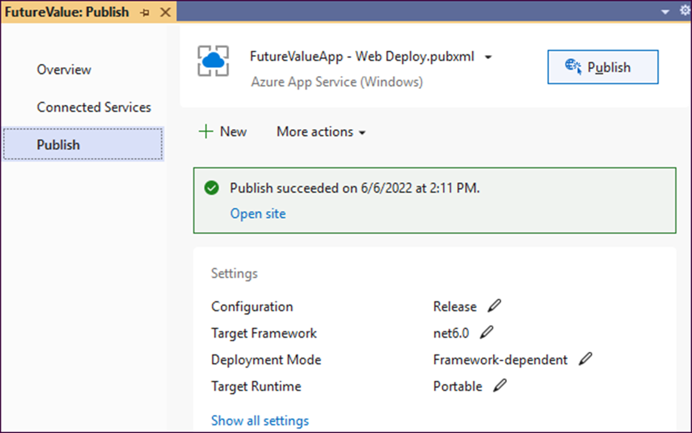
A Publish window with a published profile

Slide 6
Two ways to open the Publish window
Select the Build→Publish <project name> command from the Visual Studio menu.
Right-click the project in the Solution Explorer and select Publish….

Slide 7
How to add a new publish profile
If the project has no publish profiles, click on the Add a publish profile link.
If the project has existing publish profiles, click the New button.
How to edit a publish profile
Select the publish profile from the dropdown at the top of the window. Then, select Edit from the More actions dropdown and make the necessary changes.

Slide 8
How to rename a publish profile
Select Rename from the More actions dropdown and enter a new name in the dialog that’s displayed.
How to delete a publish profile
Select a publish profile from the dropdown at the top of the window. Then, select Delete from the More actions dropdown and click the Yes button in the Confirm delete profile dialog that’s displayed.

Slide 9
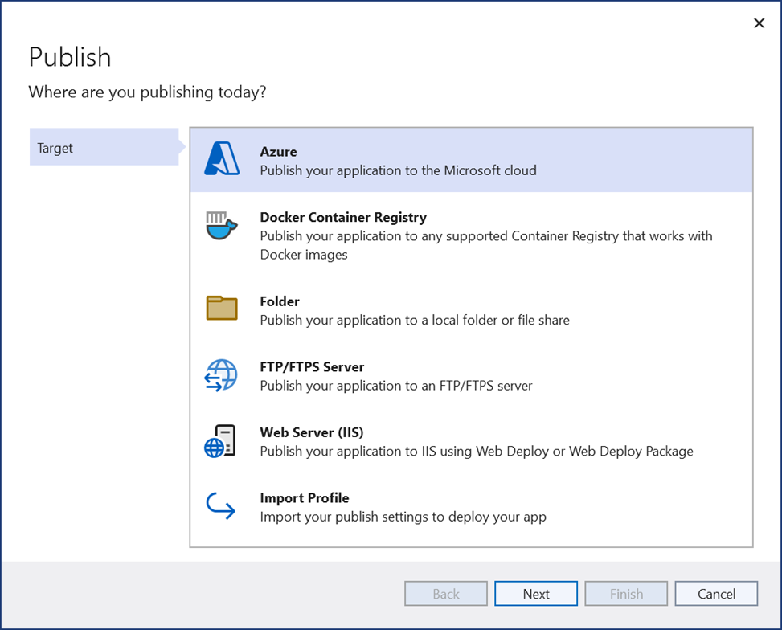
The first step of the Publish wizard

Slide 10
A URL for more information about deployment in Visual Studio
https://docs.microsoft.com/en-us/visualstudio/ deployment/deploying-applications-services-and-components

Slide 11
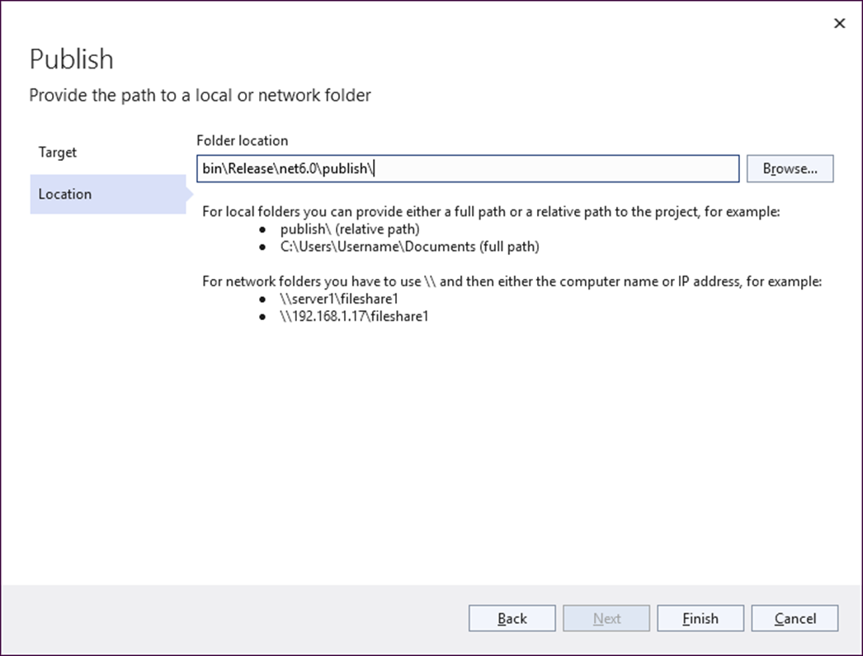
The dialog for specifying a folder location

Slide 12
How to create the publish profile
Enter the path of the folder you want to publish to in the Location step.
Click the Finish button, then click the Close button in the Finish step that’s displayed.
How to deploy to the publish folder
In the publish profile, click the Publish button. The progress will be displayed in the Output window.
To see the published files, click on the Open folder link when deployment is complete.
How to change the publish folder
Select Edit from the More actions dropdown.
Click on Connection.
Change the Target location and click Save.

Slide 13
The website to sign up for a free trial of Azure
https://azure.microsoft.com/en-us/free/dotnet/

Slide 14
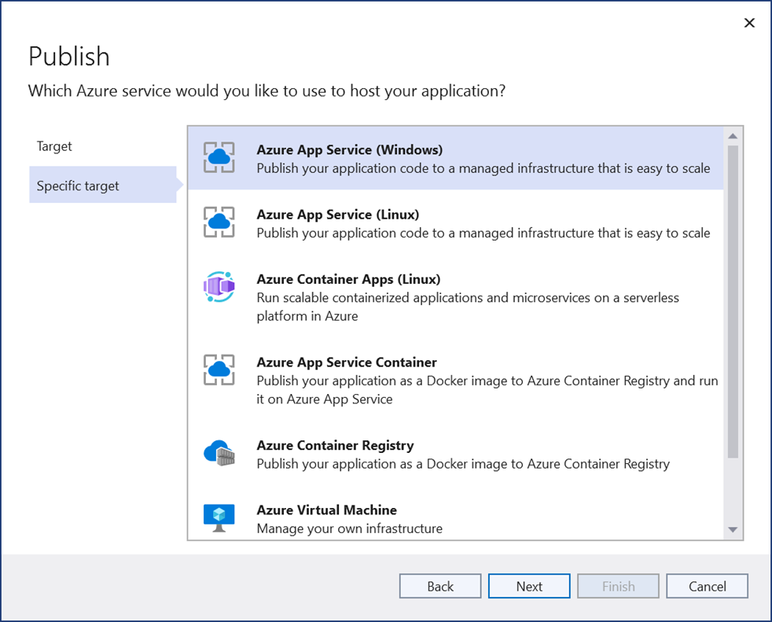
The dialog for selecting an Azure service

Slide 15
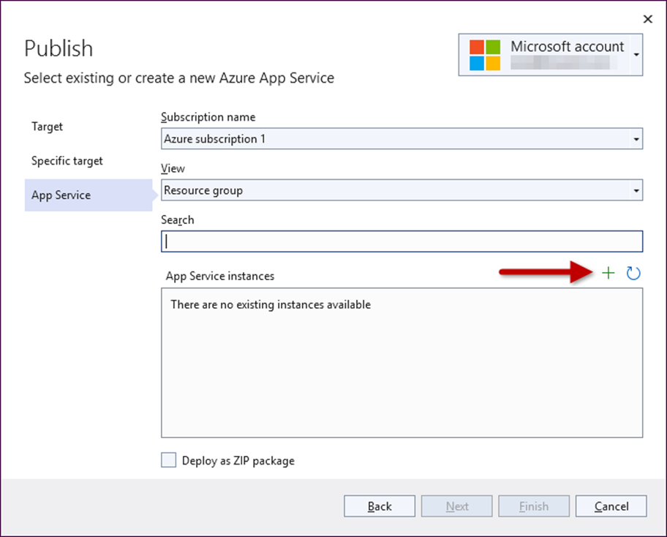
The Publish dialog for creating an Azure App Service publish profile

Slide 16
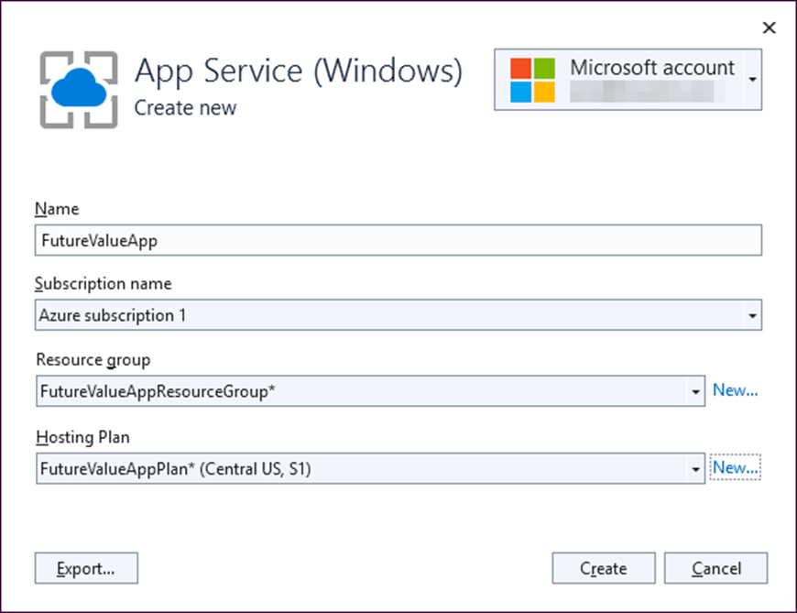
The App Service (Windows) Create new dialog

Slide 17
How to create a publish profile for an Azure App Service
In the Specific target step of the Publish wizard, select Azure App Service (Windows) or Azure App Service (Linux).
In the App Service step that’s displayed, click the plus sign above the App Service instances list box.
In the Create new App Service dialog that’s displayed, accept the default values or change them as necessary. To change the Resource group or Hosting Plan, select a different item from the dropdown or click the New… link to create a new item.
Click the Create button to return you to the App Service step.
Click the Finish button. When the creation process is complete, click the Close button to return to the Publish window.

Slide 18
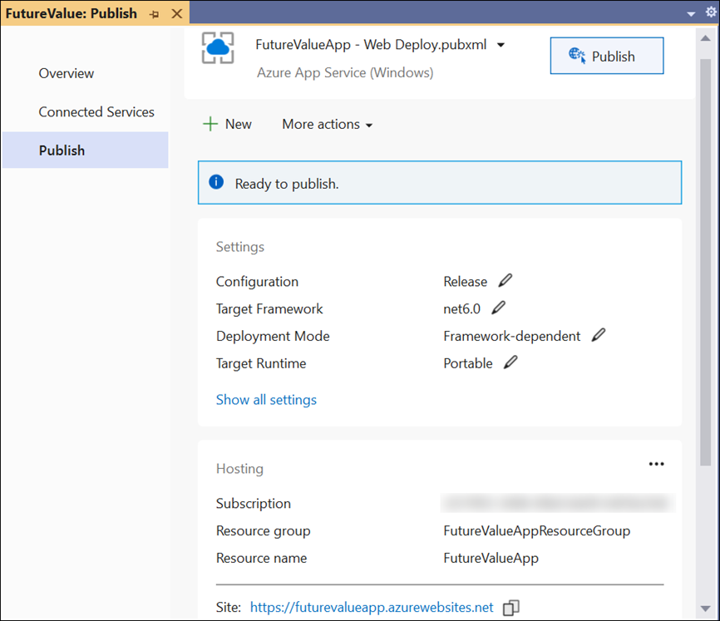
An Azure App Service publish profile that’s ready to publish

Slide 19
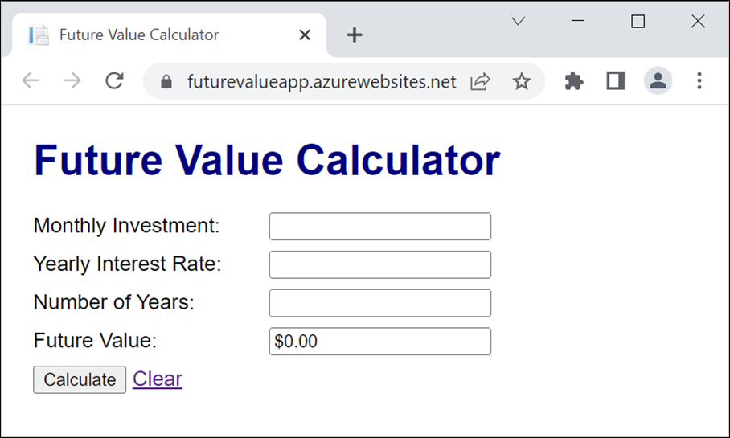
The Future Value app in a browser

Slide 20
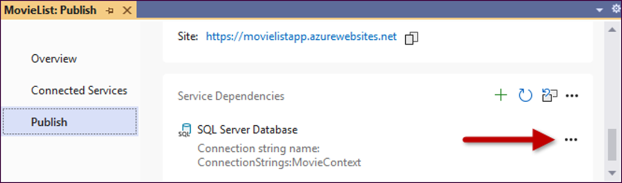
The Service Dependencies section of a publish profile

Slide 21
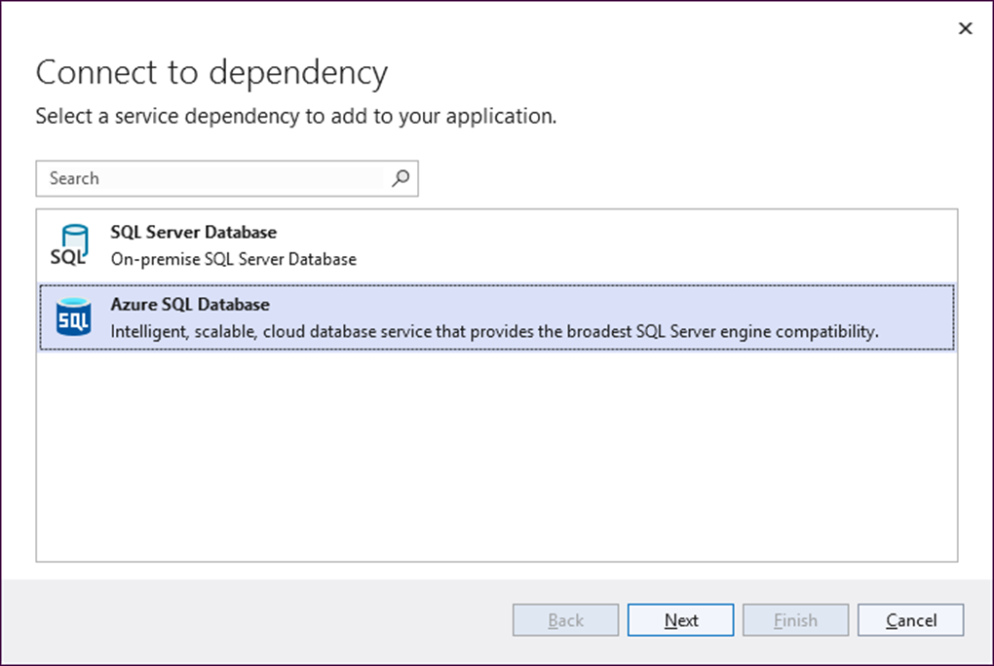
The Connect to dependency dialog

Slide 22
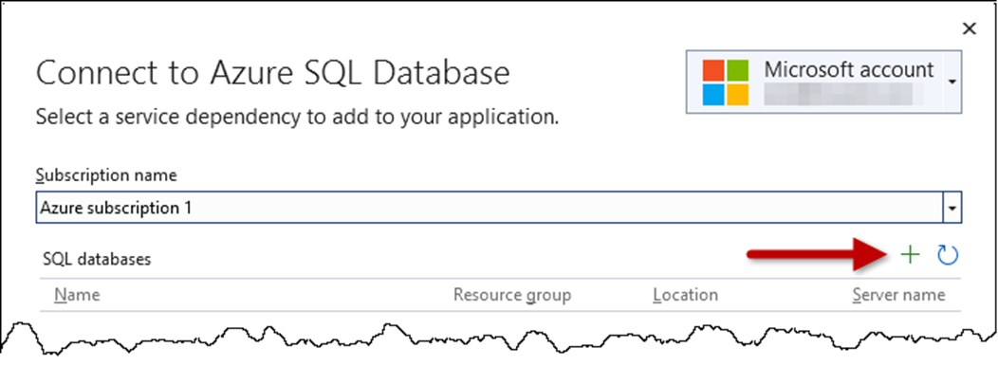
The Connect to Azure SQL Database dialog

Slide 23
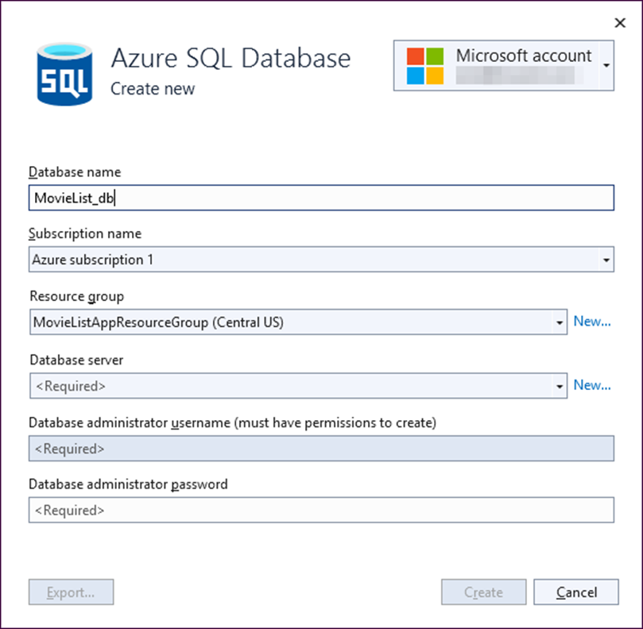
The Create new Azure SQL Database dialog

Slide 24
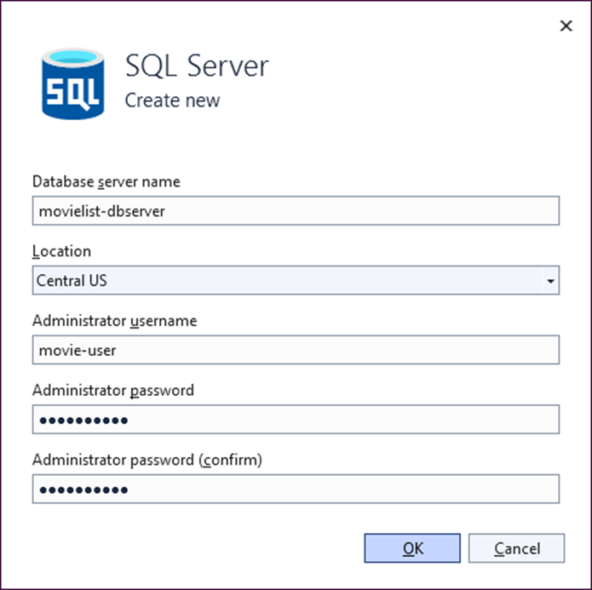
The Create new SQL Server dialog

Slide 25
How to add an Azure SQL Database to a publish profile (part 1)
Create a publish profile for the data-driven app. Be sure to use the Azure App Service (Windows) option, and be sure to add a new resource group rather than re-using an existing one.
When the profile is ready to publish, click the menu button (…) to the right of the SQL Server Database item in the Service Dependencies section of the profile and select Connect.
In the Connect to Dependency dialog that’s displayed, select Azure SQL Database and click the Next button.
In the Connect to Azure SQL Databases dialog that’s displayed, click the plus sign above the SQL databases table to display the Create New Azure SQL Database dialog.
In the Create new Azure SQL Database dialog, specify the database name.

Slide 26
How to add an Azure SQL Database to a publish profile (part 2)
Make sure the resource group you added for this application is selected.
Click the New… link to the right of the Database server textbox.
In the Create new SQL Server dialog that’s displayed, specify the server name. If the default name isn’t available, change it to one that the dialog will accept.
Enter an Admin username and password, and make a note of them for later. Click OK to return to the Create new Azure SQL Database dialog.
Click Create to create the Azure database and return to the Connect to Azure SQL Database dialog.
Select the database and click Next to display the next Connect to Azure SQL Database dialog.

Slide 27
How to add an Azure SQL Database to a publish profile (part 3)
Enter the username and password from step 9, accept the default connection string and Save option, and click the Finish button.
When the dependency configuration progress is complete, click the Close button to return to the publish profile, where a connected Azure SQL Database is now displayed.

Slide 28
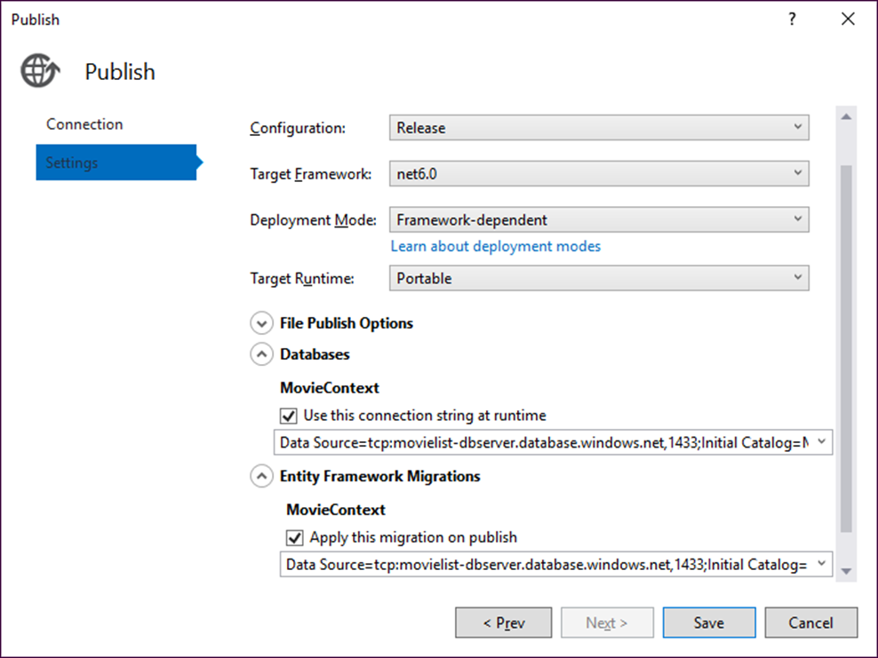
The dialog for editing the settings for a data-driven app

Slide 29
How to configure the connection string and migrations
In the publish profile, click on the Show all settings link and wait for the ‘Discovering Data Contexts...’ spinner icon to stop.
Expand the Databases section and select the Use this connection string at runtime check box.
Expand the Entity Framework Migrations section and select the Apply this migration on publish check box.
Click the Save button to return to the publish profile.

Slide 30
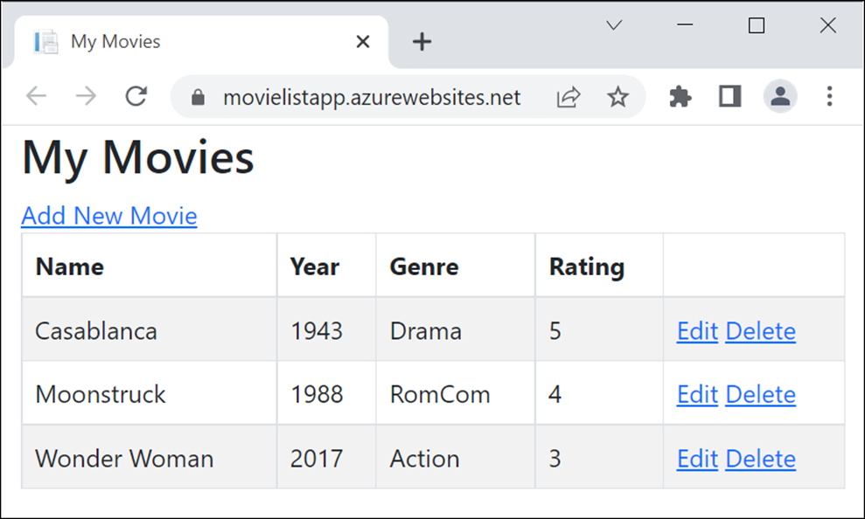
The Movie List app in a browser

Slide 31
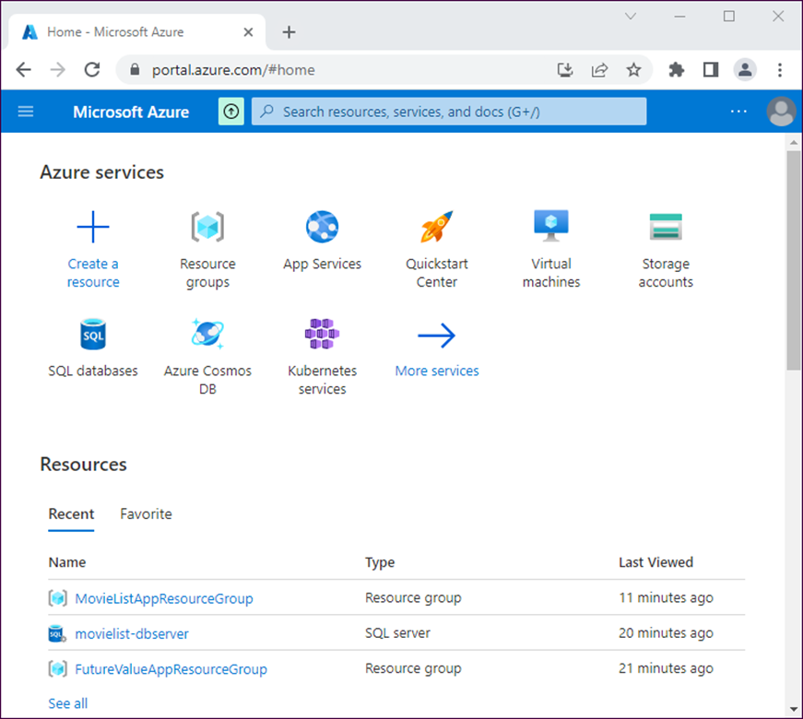
The Azure portal home page

Slide 32
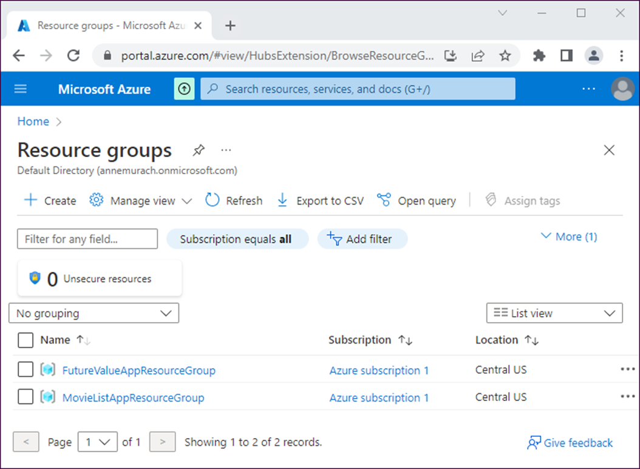
The Azure portal Resource groups page

Slide 33
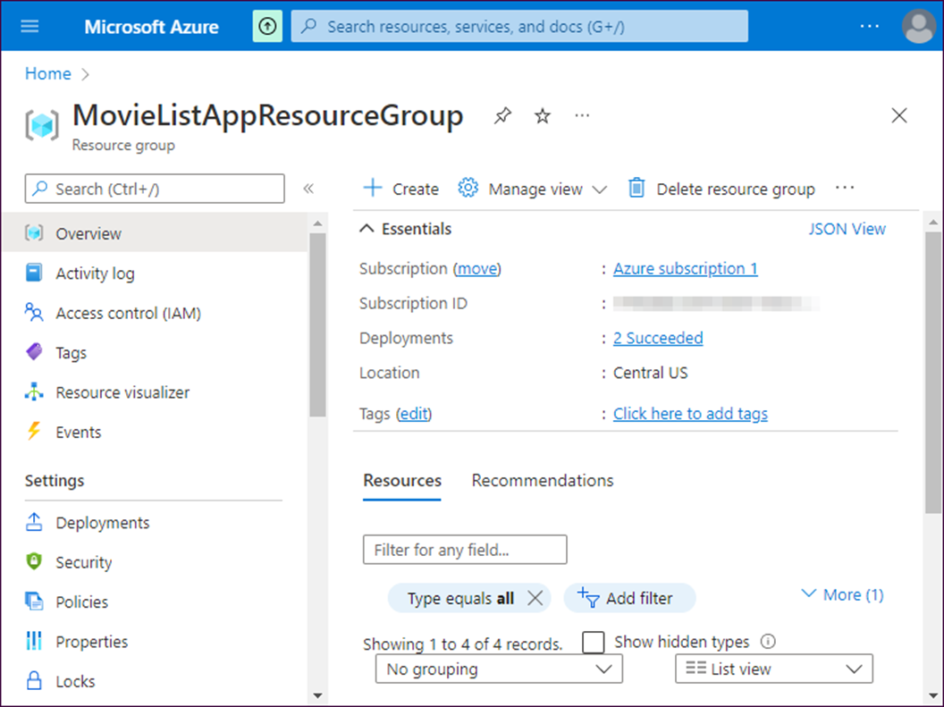
The page for a resource group

Slide 34
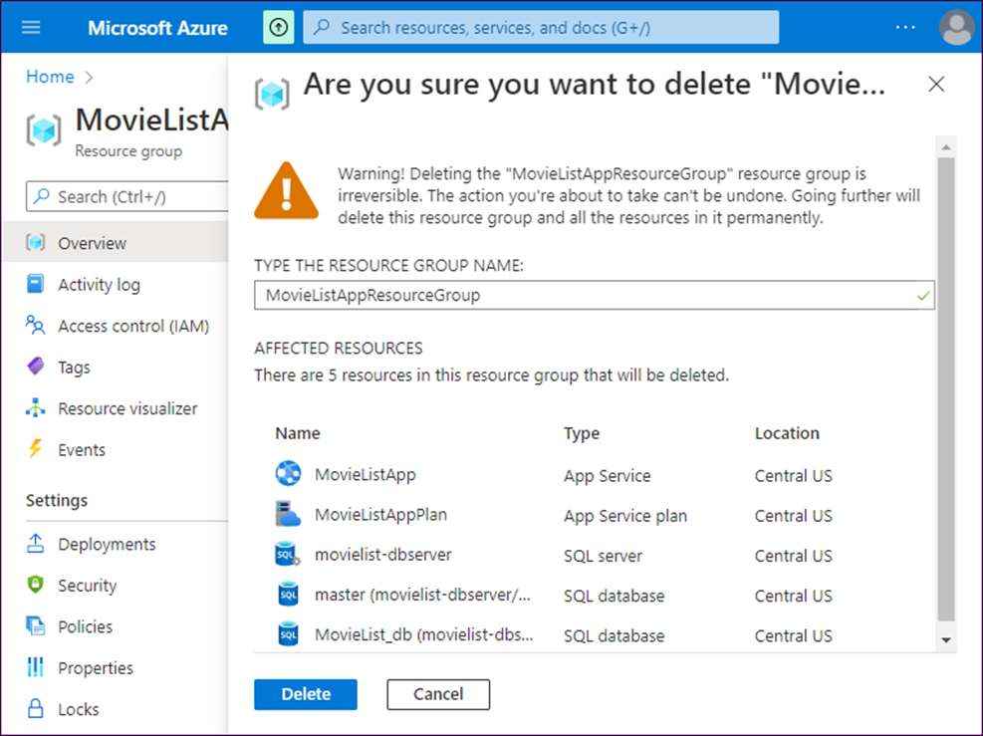
The warning when you delete a resource group

Slide 35
How to delete an Azure resource group
Log in to Azure, display the resource groups, and click on the resource group you want to delete.
In the details pane of the Overview section for the resource group, click the Delete resource group link. A warning message asking you to confirm the deletion will be displayed.
Enter the name of the resource group in the text box that’s provided and then click the Delete button.

